Slide 1
PROJECT TITLE
PIP104 PROFESSIONAL PRACTICE-II
VIVA-VOCE
Batch Number: 07
Under the Supervision of,
Dr. Nagaraja S R
Associate Professor
School of Computer Science Engineering & Information Science (Cyber Security)
Presidency University
Roll Number | Student Name
20201CCS0072 | Kaousthub Reddy H
20201CCS0085 | Aakash Adhikari
20201CCS0114 | Tushar Patel
20201CCS0122 20201CCS0149 | Mohammed Faisal Khan Md Zohaer Anfaz M.A

Slide 2
Introduction
In the context of healthcare emergencies, timely access to real-time hospital data plays a crucial role in making informed decisions promptly. Despite its importance, challenges persist in obtaining up-to-date information during critical situations. This study introduces "Hospital Finder," an innovative application designed to tackle this issue by utilizing a centralized real-time database. Hospital Finder offers users instant and precise information on hospital facilities, specialist availability, and essential medical resources.
The scarcity of real-time data has been a persistent obstacle in medical emergencies. Hospital Finder serves as a solution by leveraging a centralized real-time database to overcome challenges associated with obtaining timely information from healthcare facilities. The goal of this application is to empower individuals, healthcare providers, and emergency responders with the most relevant information during critical moments.
As we delve into the details of Hospital Finder, this paper will explore its key features, architectural design (including a use case diagram), and recommendations for incorporating real-time data into healthcare systems. Recognizing potential challenges, alternative approaches to Hospital Finder will be discussed, providing a comprehensive overview of strategies to improve access to emergency healthcare. The section on evaluation and user testing will present insights into the application's performance. The conclusion will highlight key findings, emphasizing the transformative potential of Hospital Finder in reshaping healthcare access and decision-making during emergencies.

Slide 3
Literature Review
2.1 Google Maps and Navigation Technologies
2.1.1 Historical Evolution of Mapping Technologies:
The progression of mapping technologies has been a pivotal element in the digital age, and Google Maps has become a noteworthy contributor to this domain. The article chronicles the historical advancement of Google Maps, underscoring its inception through the acquisition of 'Where 2 Technologies' by Google Inc. in 2004. This historical context aligns with the broader body of literature that recognizes the transformative impact of digital mapping applications in redefining navigation and location-based services.
2.1.2 Algorithms in Navigation:
The manuscript explores the algorithms utilized by Google Maps in navigation, particularly emphasizing Dijkstra's algorithm and the more efficient A* algorithm. This discourse on these algorithms corresponds with established literature on graph-based algorithms for optimizing routes. The examination of Dijkstra's algorithm and its drawbacks, attributed to heightened time and space complexity, echoes findings from previous studies, underscoring the necessity for more advanced algorithms in extensive applications such as Google Maps.

Slide 4
2.1.3 Street View and Image Processing:
The paper highlights the significance of introducing Google Maps' Street View feature. The incorporation of panoramic views into mapping applications is acknowledged in existing literature as a pioneering innovation. The manual capturing and processing of images, along with the utilization of Optical Flow to tackle issues such as parallax distortion, are consistent with prior research on image processing techniques in geospatial applications.
2.1.4 Geocoding and GPS Tracking:
The manuscript provides detailed insights into the function of GPS and geocoding for position identification on Google Maps. The application of Trilateration as a mathematical concept for GPS tracking corresponds with the wider body of literature on satellite-based tracking systems. The integration of WAAS (Wide Area Augmentation System) aligns with existing research emphasizing the significance of augmentation systems in improving the precision of location services based on GPS.
2.1.5 Estimated Time of Arrival (ETA) and Traffic Prediction:
The examination of estimating the time of arrival (ETA) on Google Maps is contextualized within the framework of the A* algorithm and real-time traffic information. The incorporation of multiple factors, including average speed, historical data, and officially recommended speeds, aligns with literature addressing the intricacies of forecasting travel times in dynamic settings. The focus on ongoing data collection and analysis corresponds with research underlining the significance of real-time data for precise traffic predictions.

Slide 5
2.1.6 Conclusion:
To sum up, the review of existing literature underscores the diverse facets of Google Maps, covering its historical development, algorithmic strategies, image processing methodologies, geolocation technologies, and real-time traffic forecasting. The amalgamation of these components characterizes Google Maps as a dynamic and advanced mapping tool, making substantial contributions to the broader conversation surrounding digital navigation technologies. Future studies might explore user perspectives, privacy considerations, and emerging trends in mapping applications to offer a more comprehensive insight into the field.
2.2 A smartphone based application to improve the health care system · December 2016
Healthcare is an essential requirement for every individual, and the global healthcare landscape presents both challenges and opportunities. Public healthcare systems, typically government-provided with minimal or no charges, face complexities in addressing the needs of a large patient population. To meet the increasing demand for quality healthcare, numerous private hospitals have been established. However, accessing relevant information about these facilities remains a challenge, particularly for individuals from rural areas seeking better services in urban locales.
To tackle these challenges and improve healthcare convenience for the masses, this paper suggests a web application with a comprehensive set of features. The choice of the Android platform is justified by its widespread use, affordability, and accessibility across various age groups and socioeconomic classes.

Slide 6
The proposed web application aims to offer the following features:
Online Cabin Booking System: Facilitating users in booking hospital cabins in advance.
Intelligent Hospital Suggestions: Providing recommendations based on both cost and quality metrics to assist users in selecting suitable hospitals.
Hospital Information: Offering details about the facilities and locations of hospitals.
Doctor's Chamber Information: Providing information about doctors in a city, allowing users to make appointments.
Emergency Assistance: Enabling users to make emergency calls for ambulances or healthcare services.
Medicine Reminder System: Implementing an alert system to remind users to take prescribed medicines at specific times.
Body Mass Index (BMI) Calculator: Helping users assess their BMI for health and fitness monitoring.
2.2.1 System Implementation:
The system architecture consists of two primary modules catering to administrators and general users. The administrator module facilitates the creation and modification of hospital and cabin details. On the other hand, the user module offers functionalities like online cabin booking, hospital recommendations, doctor appointments, emergency calling, medicine reminders, BMI calculation, and additional features. The development of the web application is executed on the Android OS due to its cost-effectiveness and extensive adoption.

Slide 7
2.2.2 Experimental Results:
Information for the application was gathered from ten well-known hospitals within a particular city. The objective of the application is to furnish users with precise and pertinent details, enabling them to make well-informed decisions when selecting a hospital. The assessment of quality includes evaluating factors such as the quantity of cabins, doctors, specialist physicians, and operating theaters. Feedback from a survey of 150 users indicated favorable opinions regarding the application's capability to tackle healthcare-related issues and its overall utility.
2.2.3 Conclusion:
The suggested web application acts as an all-encompassing tool to improve healthcare accessibility and convenience for users. User feedback suggests a significant perceived utility. Prospective enhancements could involve integrating artificial intelligence for symptom-based disease detection, further elevating the application's impact on daily life.
2.3 Advances in Hospital Real-Time Location Systems:
The healthcare environment is undergoing rapid changes, placing a growing emphasis on the significance of monitoring the whereabouts of individuals and items within healthcare facilities, particularly in emergency care situations. This review of literature delves into the progress made in Hospital Real-Time Location Systems (HRTLS) using innovative technologies, particularly within the healthcare landscape of Iran. The objective of the study is to offer insights into the applications, technologies, and effectiveness of HRTLS in medical environments.

Slide 8
2.3.1 Introduction:
The worldwide healthcare industry is undergoing a significant transformation, highlighting the crucial importance of real-time location tracking in mitigating challenges during emergencies and streamlining routine operations within healthcare institutions. With an increasing influx of patients requiring emergency care, hospitals encounter limitations such as resource scarcities and bed capacities. This review of literature investigates the development and importance of Hospital Real-Time Location Systems (HRTLS) in the healthcare sector, with a specific focus on the Iranian context.
2.3.2 Background:
The opening section underscores the growing significance of monitoring individuals and items within healthcare environments, particularly during crises, and acknowledges the challenges associated with this. It underscores the necessity for advanced information technologies to automate healthcare procedures, with a specific emphasis on the real-time tracking of entities within hospital premises.
2.3.3 Objectives:
The study's goals are delineated, centering on the proposition of Hospital Real-Time Location Systems (HRTLS) utilizing innovative technologies in the Iranian context. The narrative review methodology is presented, encompassing the collection and examination of articles and reports from pertinent sources spanning the period between 2006 and 2017.

Slide 9
2.3.4 Methods:
The methodology for the review entails an extensive exploration across databases including IDTechEx, IEEE, PubMed Central, Science Direct, EMBASE/Excerpta Medica, Scopus, Web of Science, Elsevier journals, WHO publications, and Google Scholar. The criteria for inclusion and exclusion, governing the selection of pertinent literature, are explicitly outlined.
2.3.5 Results:
The review discloses findings derived from the scrutiny of Hospital Real-Time Location Systems (HRTLS) applications in 15 specified countries, encompassing Australia, Belgium, Canada, Germany, Iran, Italy, Japan, Luxembourg, Mexico, Netherlands, Russia, South Korea, Turkey, the United Kingdom, and the United States. The applications are classified into eight distinct groups, which comprise tracking systems for elderly care, medical asset tracking, security for children and the elderly, monitoring blood transfusions, tracking medications, patient monitoring, real-time data collection, and healthcare environment monitoring.
2.3.6 Discussion:
In the discussion segment, an exploration of the ramifications of Hospital Real-Time Location Systems (HRTLS) in healthcare institutions is undertaken, highlighting its capacity to improve patient safety, streamline workflow, and enhance overall efficiency. The analysis considers challenges such as technological constraints, interoperability issues, privacy considerations, and the substantial implementation cost.

Slide 10
2.3.7 Implications for HRTLS:
The results bear significance for healthcare managers by offering guidance on the selection of Hospital Real-Time Location Systems (HRTLS) technologies that suit the particular needs of their organizations. The successful implementation of HRTLS is underscored by recognizing the economic implications and prioritizing policies related to patient and staff satisfaction.
2.3.8 Conclusion:
The concluding remarks underscore the importance of real-time location systems in attaining healthcare objectives, emphasizing the enhancement of efficiency, elevation of patient satisfaction, and reduction of time and costs. The research advocates for the incorporation of innovative technologies, such as the Internet of Things (IoT) and cloud computing, to develop and deploy comprehensive Hospital Real-Time Location Systems (HRTLS) within healthcare centers in Iran.
2.3.9 Ethical Considerations:
The conclusion recognizes ethical considerations, underscores the importance of maintaining the integrity of the research process, and emphasizes the significance of adhering to ethical standards in healthcare research. This review offers a thorough summary of the present status of Hospital Real-Time Location Systems (HRTLS), encompassing its applications, challenges, and implications in the healthcare sector, with a particular emphasis on the context of Iran.

Slide 11
Research Gaps Identified
3.1 Google Maps Literature Review (2.1.6 Conclusion):
Research Gap: The current research lacks in-depth exploration of user experiences and privacy concerns associated with the utilization of Google Maps.
Future Research Opportunities: There is a need to delve into user perceptions, concerns, and experiences regarding privacy features and the usability of Google Maps.
3.2 Healthcare Real-Time Location Systems (2.3.8 Conclusion):
Research Gap: The current body of research does not adequately address the challenges and concerns linked to the adoption of IoT and cloud computing in implementing HRTLS in healthcare centers in Iran.
Future Research Opportunities: There is potential for future research to investigate obstacles and ethical issues related to integrating IoT and cloud computing in Iranian healthcare settings.

Slide 12
3.3. IoT System Acceptance Testing in Healthcare (2.4.9 Conclusion):
Research Gap: The current research has a limited focus on the scalability and generalizability of the proposed acceptance testing method for IoT applications in healthcare.
Future Research Opportunities: Future research should explore the adaptability of the proposed testing methodology to different healthcare scenarios and assess its scalability in larger-scale IoT implementations.
3.4 User Satisfaction Evaluation in Mobile Medical Apps (2.5.11 Conclusion and Contributions):
Research Gap: There is insufficient exploration of cultural and demographic factors that may influence user satisfaction with mobile medical apps.
Future Research Opportunities: Future research should examine the impact of cultural and demographic variables on user satisfaction to improve the applicability of the proposed model in diverse user populations.
3.5 Smartphone Medical Apps Landscape (2.6.6 Conclusion):
Research Gap: The current research has limited exploration of potential security and privacy concerns associated with the integration of wearable gadgets and biosensors in smartphone medical apps.
Future Research Opportunities: Future research should investigate the security implications and privacy considerations when integrating wearable technologies with smartphone medical apps.

Slide 13
3.6 Reinforcement Learning in Healthcare for Psychological Applications (2.7.13 Conclusion):
Research Gap: There is limited examination of the long-term ethical implications and potential biases introduced by RLHF in psychological applications.
Future Research Opportunities: Future research should explore the ethical considerations and potential biases associated with the long-term use of RLHF in psychological applications.
3.7 Healthcare Application Contextualization (2.8.9 Conclusion):
Research Gap: There is limited discussion on potential challenges and barriers to the practical implementation of the proposed healthcare application in real-world settings.
Future Research Opportunities: Future research should investigate the practical challenges, implementation barriers, and stakeholder perspectives related to deploying the proposed healthcare application.
3.8 NoSQL Databases in Database Management (2.9.9 Conclusion):
Research Gap: There is insufficient exploration of specific use cases or industries where NoSQL databases may outperform traditional relational databases.
Future Research Opportunities: Future research should examine industry-specific scenarios to identify contexts where NoSQL databases offer distinct advantages over traditional relational databases."

Slide 14
2.4 Application of Model-Based Software Testing in Healthcare Domain
The incorporation of Internet of Things (IoT) technologies in the healthcare sector is a rapidly growing domain, characterized by the creation of inventive solutions aimed at improving patient care, optimizing processes, and enhancing overall healthcare results. This review explores key facets of IoT in healthcare, placing a focus on the importance of rigorous testing methodologies, specifically acceptance testing, to guarantee the dependability and security of these systems.
2.4.1 IoT in Healthcare:
The Internet of Things (IoT) is defined as a system of interconnected physical objects and devices that exchange data through central control servers based in the cloud. The utilization of IoT in healthcare offers significant possibilities, allowing for the remote monitoring and management of medical equipment and resources. Nevertheless, the swift evolution of IoT technology introduces complexities that require comprehensive testing.
2.4.2 Challenges in IoT Software Testing:
Although the Internet of Things (IoT) has been extensively embraced across diverse industries, there is a noticeable dearth of research concerning the testing of IoT software within the healthcare sector. The array of technologies utilized in the development of IoT systems presents challenges for efficient testing, and there is a limited presence of proposed solutions and approaches in this specific domain.

Slide 15
2.4.3 Healthcare Software Development and Testing:
The healthcare sector, known for its complex and unique demands, is undergoing substantial changes. Innovations like wearable technology and hospital indexing systems are reshaping the landscape of patient care. Due to the complexity of healthcare products, thorough testing is essential to guarantee quality, given the potential consequences on patient well-being, consumer costs, data privacy, and overall safety.
2.4.4 Integration of IoT and Deep Learning in Healthcare:
Suggestions such as incorporating Internet of Things (IoT) and deep learning methods highlight the potential for remote health monitoring and data analysis. The integration of IoT with a cloud network structure allows for the instantaneous collection and analysis of data, offering prompt assistance to individuals in critical conditions.
2.4.5 Security Testing in Healthcare Applications:
As healthcare increasingly depends on technology, the crucial need for security testing becomes evident. The security of patient data, especially health-related information, is paramount to prevent severe data breaches. Security testing is essential to guarantee that healthcare applications are not only secure but also resilient and free of errors across various scenarios.

Slide 16
2.4.6 Big Data Solutions in Healthcare:
The healthcare sector produces extensive datasets, encompassing detailed patient information. Big data solutions play a pivotal role in facilitating informed decisions regarding disease cures, research and development, and other healthcare-related aspects. Comprehensive testing of this data is imperative to guarantee its accurate implementation and achieve the desired outcomes.
2.4.7 Acceptance Testing in Healthcare Software:
Despite the pivotal role of software in healthcare, there is a notable dearth of research on acceptance testing within this field. Existing literature highlights challenges and progress in model-based testing and approaches to evaluating mobile usability. The suggested framework for acceptance testing in Internet of Healthcare Technology (IoHT) systems employs the user interface as the primary interaction medium, concentrating on black-box testing and verification using UML activity diagrams
2.4.8 UML Activity Diagrams in Test Generation:
UML activity diagrams prove to be a valuable resource for modeling interactive attributes and facilitating the development of test cases. Existing literature underscores the utilization of activity diagrams for constructing activity flow graphs, extracting pertinent details, and generating test cases according to activity path coverage criteria. An illustrative case study involving a diabetic telehealthcare scenario demonstrates the practical implementation of this methodology.

Slide 17
2.4.9 Conclusion:
The examined literature suggests a technique for conducting acceptance testing in IoT systems, specifically within the healthcare sector, using UML activity diagrams. The focus is on an efficient and cost-conscious method, and the application of this approach to a practical telehealthcare test case scenario emphasizes its potential usefulness. The collaborative efforts of multiple authors have played a role in shaping and refining this testing methodology, offering insights that could be valuable to practitioners dealing with similar challenges in ensuring the quality of IoT applications in healthcare.
In summary, the literature review underscores the crucial necessity for effective testing methodologies in the dynamic landscape of IoT in healthcare. The proposed acceptance testing approach, guided by UML activity diagrams, addresses existing research gaps and contributes to the establishment of dependable and secure IoT systems for healthcare applications.

Slide 18
Proposed Methodology
4.1 Project Initiation:
⦁Define project scope, objectives, and deliverables.
⦁Assemble a cross-functional team of developers, data scientists, and healthcare experts.
⦁Allocate resources and establish project timelines.
4.2 Requirements Analysis:
⦁Gather and document detailed functional and technical requirements based on the problem statement and objectives.
⦁Identify key features such as hospital search, recommendation algorithms, user registration, feedback mechanisms, and geospatial services.

Slide 19
4.3 Technology Stack Selection:
⦁Web App (Flutter for cross-platform development)
⦁Web App (Flutter for cross-platform development)
⦁Backend (Node.js for server-side development)
⦁Database (Firebase Realtime Database or Firestore for data storage)
⦁Machine Learning (Python with relevant libraries, such as scikit-learn or TensorFlow)
4.4 System Architecture Design:
⦁Design the system architecture, including the mobile and web app components, databases, and machine learning models.
⦁Create an API design for data communication between the web app and the backend.
4.5 Development:
web App (Flutter):
⦁Implement the web app using Flutter, focusing on a user-friendly and intuitive interface.
⦁Integrate geospatial services for precise location data.
⦁Develop user registration and feedback mechanisms.
⦁Implement search functionality for nearby hospitals.
Backend (Node.js):

Slide 20
4.6 Machine Learning:
⦁Develop and train Machine Learning models to analyze user preferences and hospital data.
⦁Fine-tune recommendation algorithms to offer personalized hospital suggestions based on medical requirements.
⦁Ensure the models can handle real-time data updates and integrate seamlessly with the backend.
4.7 Data Integration:
⦁Integrate Firebase for data storage and authentication.
⦁Set up real-time data synchronization between the web app and Firebase to provide live updates.
4.8 Testing:
⦁Conduct thorough testing, including unit testing, integration testing, and user acceptance testing.
⦁Test geospatial accuracy, data reliability, and recommendation accuracy.
⦁Address any issues and refine the application based on user feedback.

Slide 21
Objectives
5.1 Efficient Hospital Search:
Provide users with a user-friendly interface for searching and locating nearby hospitals quickly and efficiently.
5.2 Tailored Hospital Recommendations:
Employ Machine Learning algorithms to offer hospital recommendations based on the user's specific medical requirements, such as treatment, specialist doctors, and medicine/blood availability.
5.3 Real-time Information:
Ensure that the application provides up-to-date information on hospital facilities, services, and the availability of essential medical resources.
5.4 Emergency Preparedness:
Assist users in making informed decisions during medical emergencies, helping them find the most suitable hospital promptly.

Slide 22
5.5 Improved Health Outcomes:
Contribute to better health outcomes by connecting users to hospitals that offer the required expertise, treatment, and resources.
5.6 Reduce Search Time:
Minimize the time and effort individuals spend in searching for appropriate healthcare facilities, ultimately leading to faster access to care.
5.7 User-Friendly Interface:
Design a simple, intuitive, and easy-to-navigate interface to cater to a wide range of users, including those in distress.
5.8 Enhanced Transparency:
Promote transparency in the healthcare system by providing information about hospitals' services, specialities, and resources, facilitating informed decision-making.

Slide 23
5.9 Geospatial Accuracy:
Utilize geospatial technology to ensure precise location information, enabling users to find the nearest healthcare options.
5.10 Public Awareness:
Promote the application to reach a wider audience, ensuring that more individuals have access to its benefits during medical emergencies.
5.11 Feedback Mechanism:
Implement a feedback system for users to share their experiences, thereby improving the quality of recommendations and information provided.
5.12 Continual Improvement:
Regularly update and refine the application, incorporating user feedback and emerging technologies to enhance its performance and relevance.

Slide 24
5.13 Promote Healthcare Equity:
Ensure that the application is accessible to a wide range of users, promoting healthcare equity by aiding underserved communities in making informed healthcare decisions.
5.14 Community Engagement:
Foster a sense of community by encouraging users to share valuable insights and information that can benefit others in their vicinity.
5.15 Data Security:
Prioritize data security and privacy, safeguarding users' personal and medical information.
5.16 Collaboration with Healthcare Providers:
Establish partnerships with hospitals, clinics, and healthcare institutions to ensure the accuracy and completeness of information presented within the application.

Slide 25
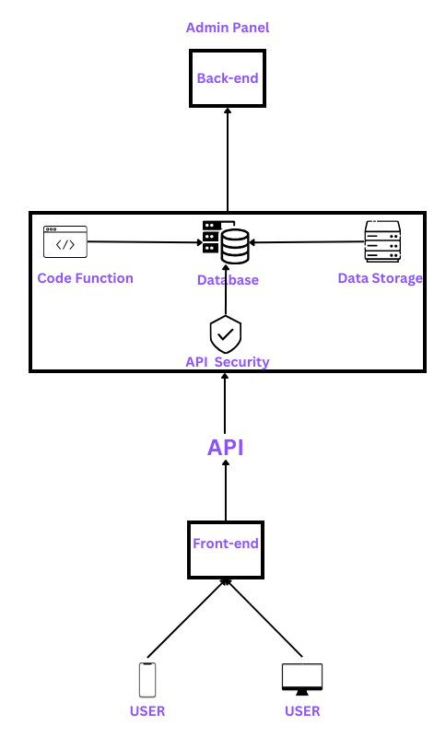
System Design &
Implementation
6.1 System Design:
The intricately architected system in question represents a pinnacle of technological sophistication, embodying a multifaceted and nuanced approach to digital infrastructure. At its core, this system seamlessly amalgamates an administrative panel endowed with direct access to the backend, while concurrently harnessing the power of a secure and efficient API interface to bridge the frontend with the intricacies of the backend machinery. This architectural duality is not merely a testament to organizational prowess but serves as a testament to the deliberate pursuit of enhanced system manageability, scalability, and adaptability in the face of dynamic technological landscapes.

Slide 26
Delving into the administrative realm, the dedicated panel emerges as a central command nexus, empowering administrators with an unparalleled vantage point for overseeing and orchestrating intricate backend operations. The immediacy and granularity of control afforded by this direct backend access become instrumental in effecting real-time adjustments, optimizations, and troubleshooting, fostering an ecosystem where responsiveness to evolving demands is not just a virtue but a fundamental characteristic.
On the flip side of this technological tapestry lies the frontend, intricately interwoven with the backend through a meticulously designed API layer. This strategic decoupling of the frontend and backend not only exemplifies a modular approach but also facilitates the deployment of a diverse array of frontend applications without necessitating disruptive modifications to the foundational backend infrastructure. The API, serving as the linchpin of this symbiotic relationship, provides a standardized conduit for seamless communication, thereby augmenting interoperability and elevating the end-user experience to unprecedented heights.
Yet, the pièce de résistance of this technological symphony lies in the integration of Akamai's formidable API security apparatus. As a globally recognized authority in content delivery and cloud services, Akamai bestows upon the API layer an impenetrable shield against potential security threats and vulnerabilities. This fortified security paradigm encompasses an array of cutting-edge measures, encompassing robust encryption protocols, proactive threat detection mechanisms, and swift mitigation strategies. By leveraging Akamai's unparalleled expertise, the system attains a zenith of resilience against the omnipresent specter of cyber threats, ensuring that the data traversing the intricate interplay between the frontend and backend remains sacrosanct in terms of confidentiality, integrity, and availability.

Slide 27
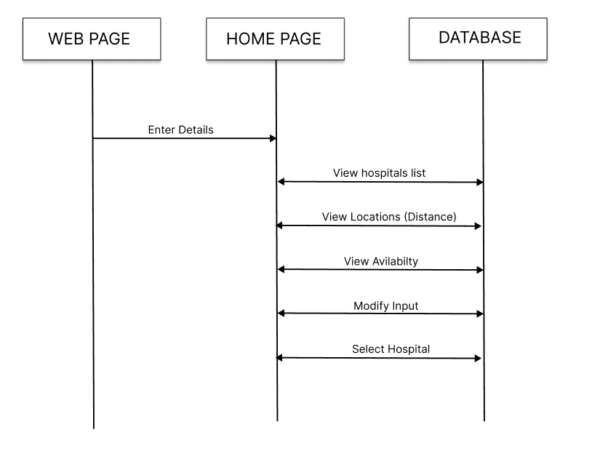
6.2 Sequence Diagram Of User:
In the intricate and expansive narrative depicted by this meticulously crafted sequence diagram, the user's foray into the web page interface unfolds as a symphony of interactions, each note resonating with the complexity and depth inherent in the digital orchestration. The overture commences with the user's poised engagement at the homepage, where they embark on a journey of information exchange by inputting a myriad of essential details, thereby initiating a sequence of events that traverse the intricate landscape of the system's architecture.

Slide 28
The web page, akin to a blank canvas, transforms into a dynamic tapestry as the user populates it with data, signaling the inception of a collaborative exchange of information.
As the user's keystrokes imbue the web page with life, the backend of the system assumes the role of a virtuoso conductor, orchestrating a harmonious ensemble of database calls. This pivotal juncture is demarcated by a graceful downward arrow, symbolizing the unidirectional flow of information from the user interface to the backend, where a complex dance with the database ensues. Armed with location-specific parameters, the backend intricately navigates the database, issuing tailored queries to extract a trove of data reflective of the user's specified criteria. This symbiotic exchange is a pivotal symphony, transforming raw data into a melodic composition of meaningful insights, laying the foundation for the subsequent movements in the grand symphony of user interaction.
The subsequent segment of this elaborate ballet unfolds with the backend processing the acquired details, transforming them into a curated menu of options presented to the user on the digital stage. This menu, a versatile palette of choices including "View Hospitals," "View Location," "View Availability," "Modify Input," and "Select Hospital," serves as a user-centric toolkit, bestowing upon the user an unparalleled agency in sculpting their digital experience. The arrows connecting these options delineate a dynamic dance, allowing the user to pirouette seamlessly between functionalities, emphasizing a design philosophy that places user empowerment at the forefront.

Slide 29
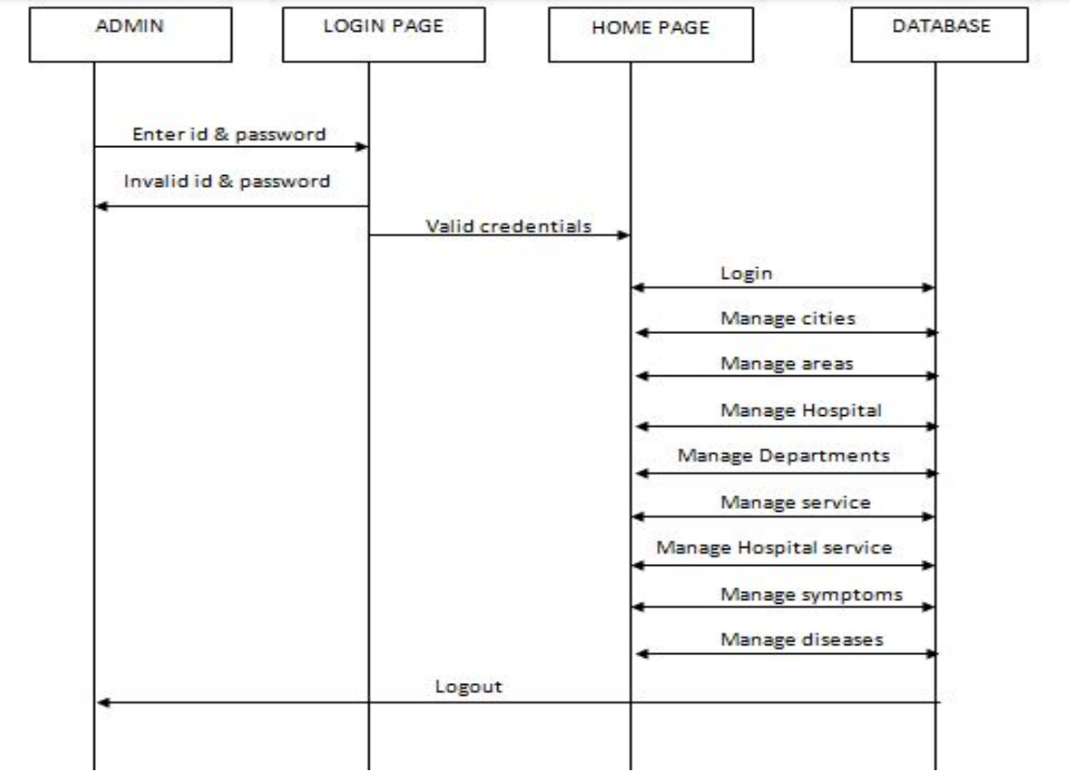
6.2.2 Sequence Diagram Of Admin:
The symmetrical and organized nature of the sequence diagram not only visually conveys the logical flow of actions within the administrative realm but also symbolizes the structured nature of administrative processes. Decision points and conditional branches, intricately woven into the diagram, underscore the flexibility and adaptability inherent in the administrative workflow, allowing administrators to navigate through diverse scenarios and contingencies with finesse.

Slide 30
In the expansive canvas of the sequence diagram detailing the intricate orchestration of administrative processes, a panoramic tapestry unfolds, revealing the nuanced ballet of actions and interactions that characterize the administrative workflow within the system. The symphony begins with the initiation of the sequence by the administrative persona, who, from the helm of the admin panel interface, serves as the conductor of this digital symphony. This initial interaction sets in motion a dynamic series of events, illustrated by a cascade of arrows symbolizing the unidirectional flow of commands and responsive actions.The opening act encompasses the admin panel dispatching commands that act as catalysts for backend processes. These backend processes, akin to the unseen machinations backstage, encompass a multifaceted array of tasks such as user authentication, data retrieval, and system updates. The backend, in this orchestral analogy, assumes the role of a well-coordinated ensemble, responding to the maestro's commands by executing a symphony of operations with precision and synchrony.
As the administrative ballet progresses, the admin panel becomes the focal point for receiving feedback and updates from the backend, marked by arrows flowing back to the admin interface. This dynamic feedback loop exemplifies the real-time responsiveness of the system, affording administrators immediate insights into the outcomes of their commands and interventions. It is a digital dialogue between the administrator and the system, where every command initiates a responsive chord, resonating through the administrative landscape.The subsequent movements of this administrative symphony unfold as various functionalities take center stage, represented as distinct branches in the diagram. These functionalities encompass the intricacies of user management, system configuration, data analysis, and potentially even decision-making processes. Each branch, akin to a narrative subplot, contributes to the overarching storyline of administrative control and oversight, forming a rich and complex narrative tapestry.

Slide 31
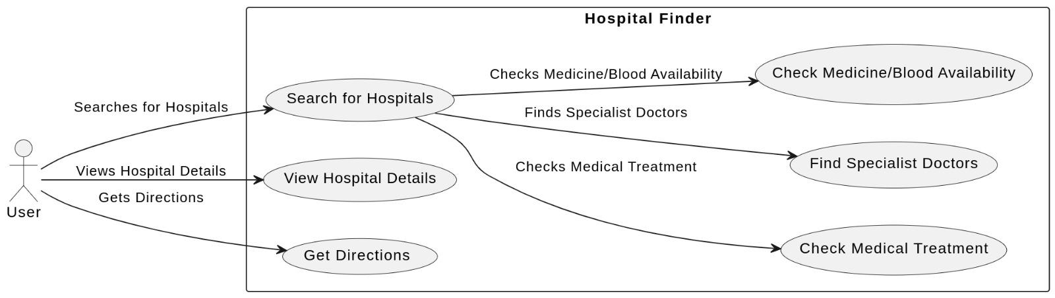
6.4 Use Case Diagram:
In the expansive landscape of the use case diagram depicting the intricacies of a Hospital Finder Application, a comprehensive narrative unfolds, delineating the multifaceted interactions and functionalities inherent in this digital healthcare ecosystem. At the heart of this diagram lies the central actor, the end user, representing individuals seeking medical care and services. The primary use cases radiate from this central figure like spokes, embodying the diverse functionalities encapsulated within the application.

Slide 32
The user initiates the sequence by accessing the application, setting in motion a series of interconnected use cases that collectively orchestrate the user experience. These include "Search Hospitals," where users input specific criteria such as location, specialty, or services required, initiating a dynamic process of information retrieval and filtering. The "View Hospital Details" use case further allows users to delve into comprehensive information about a particular healthcare facility, including services offered, reviews, and contact details.
The application responds adeptly to the user's needs through the "Check Availability" use case, facilitating real-time information on the availability of medical services, appointment slots, and relevant logistical details. A critical use case, "User Registration/Login," ensures a secure and personalized experience, allowing users to create accounts, manage profiles, and access personalized features. The "Review Hospitals" use case enables users to contribute feedback, fostering a collaborative and transparent environment that aids others in their decision-making process.
The administrative facet of the Hospital Finder Application is elucidated through use cases such as "Manage Hospitals" and "Update Availability," empowering healthcare institutions to maintain accurate and up-to-date information on their profiles. The "Generate Reports" use case serves as a pivotal tool for administrators to extract insights and analyze user interactions, facilitating strategic decision-making and system optimization.Interwoven throughout the use case diagram are essential system functionalities, including "Notification Management" to keep users informed about appointments, updates, and relevant information.

Slide 33
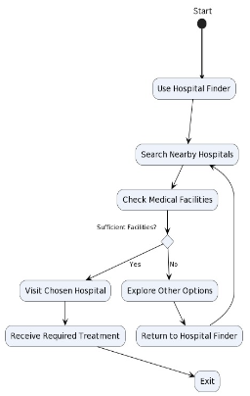
6.5 Activity Diagram:
In the activity diagram the user will go to the website ‘Hospital Finder’ and click on the search bar to find the hospitals nearby by writing the disease, hospital or availability name. user will check for the medical facility is sufficient or not:-
if yes:-
the user will choose the hospital and get the location details and map to navigation to the hospital using google API and then exit.
if no:-
Users can search for other options or other filters like emergency medications, blood availability, tests, specialists etc.And again get the details and navigation to the hospitals.

Slide 34
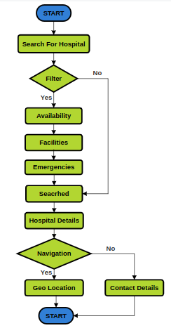
6.6 Flowchart Diagram:
Start:-
The process begins here.
Search for hospital:-
2.1 Search Bar:-
Search the hospital name or disease name to get a hospital list.
2.2 Filter:-
If ‘yes’:-
Searched based on Availability
Searched based on Specialists
Searched based on Medications
Searched based on Test
If ‘no’:-
Search hospital

Slide 35
3. Hospital Details:-
Availability of Blood
Availability of Emergency Medications
Tests available
Hospital address
Hospital contact details
Average hospital cost
Distance of hospital from user
Geolocation points of hospital
3.1 Navigation:-
if ‘yes’:-
Hospital Geo Location and navigation using google API
If ‘no’:-
Contact details of hospital with address and emergency number
4. End:-
The process end here

Slide 36
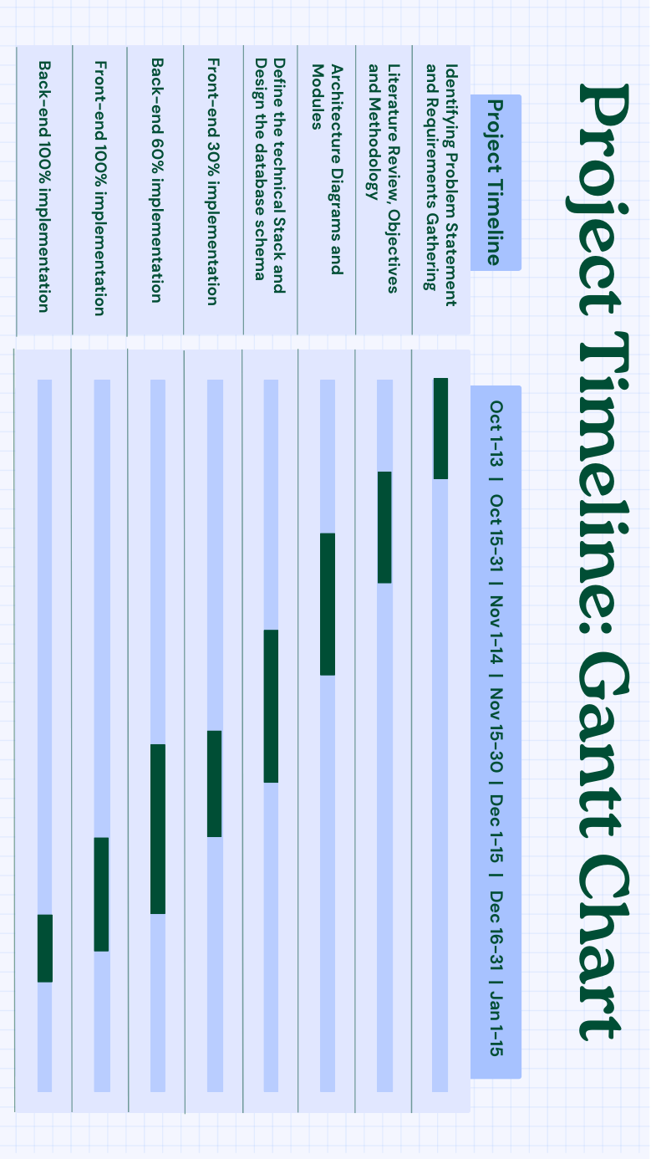
Timeline of Project

Slide 37
Outcomes / Results Obtained
8.1 Improved Healthcare Access:
Ensure that individuals can quickly and easily find appropriate healthcare facilities, reducing barriers to accessing essential medical care.
8.2 Enhanced Decision-Making:
Enable users to make well-informed decisions during medical emergencies, leading to better treatment outcomes.
8.3 Efficient Resource Utilization:
Promote the efficient utilization of hospital resources by matching patients with hospitals that can best address their needs, reducing overcrowding and wait times.
8.4 User Satisfaction:
Strive for high user satisfaction by providing a user-friendly, reliable, and accurate healthcare resource search experience.

Slide 38
8.5 Timely Assistance:
Ensure that individuals receive timely medical assistance during emergencies, potentially saving lives and reducing the severity of health conditions.
8.6 Reduced Stress and Anxiety:
Minimize the stress and anxiety experienced by individuals and their families when searching for healthcare options during critical situations.
8.7 Promotion of Health Equity:
Contribute to reducing healthcare disparities by offering equitable access to healthcare information and resources for all users.
8.8 Community Building:
Foster a sense of community by encouraging users to share information and experiences, creating a supportive network of individuals seeking medical care.
8.9 Data Accuracy:
Continuously strive for the highest level of data accuracy and reliability to maintain trust among users.
Continuous Improvement: Regularly update and improve the application based on user feedback, technological advancements, and changes in healthcare services.

Slide 39
Conclusion
Our effort has produced a system that is intended to provide a wealth of information on different hospitals. This cutting-edge tool makes it simple for users to get hospital-related data by delivering it online and through SMS in a seamless manner. Patients who integrate this healthcare application are provided with a carefully selected list of hospitals in their area, along with information about the services that each one offers. The software acts as a clearinghouse for relevant hospital data, including speciality offerings, service categories, and more. Its functionality includes the ability for users to send SMS requests for information, which has shown to be both functional and consistent with our expectations, as evidenced by its current 8.2 rating.
FUTURE ENHANCEMENTS
Understanding that there is always room for improvement, the application can progress even farther with improvements focused on the needs of the user. One approach is to utilize surveys to get user feedback so that the app can be improved according to what the majority of users need most. A tool that allows users to evaluate and compare other hospitals and their offerings might be a crucial addition, enabling people to make well-informed selections. Creating a forum where people can talk about their experiences as patients could be a great way to help newcomers have a better understanding of what to expect from different medical facilities. These improvements are in line with our mission to continuously improve the usability and utility of the application, empowering and enlightening the community of people looking for healthcare.

Slide 40
References
[1] Mehta, Heeket & Kanani, Pratik & Lande, Priya. (2019). Google Maps. International Journal of Computer Applications. 178. 41-46. 10.5120/ijca2019918791.
[2] Imteaj, Ahmed & Hossain, Md. (2016). A smartphone based application to improve the health care system of Bangladesh. 1-6. 10.1109/MEDITEC.2016.7835358.
[3] Iran J Public Health, Advances in Hospital Real-Time Location Systems, Vol. 48, No.4, Apr 2019, pp.593-602
[4] Jha, Pragya & Sahu, Madhusmita & Bisoy, Sukant & Sain, Mangal. (2022). Application of Model-Based Software Testing in the HealthCare Domain. Electronics. 11. 2062. 10.3390/electronics11132062.
[5] Int J Environ Res Public Health. 2022 Jun; 19(12): 7466. Published online 2022 Jun 17. doi: 10.3390/ijerph19127466

Slide 41
[6] Hussain, Muzammil & Al-Haiqi, Ahmed & Zaidan, A. & Bahaa, Bilal & Mat Kiah, Miss Laiha & Anuar, Nor & Abdulnabi, Mohamed. (2015). The Landscape of Research on Smartphone Medical Apps: Coherent Taxonomy, Motivations, Open Challenges and Recommendations. Computer methods and programs in biomedicine. 122. 10.1016/j.cmpb.2015.08.015.
[7] Fine-tuning a Large Language Model using Reinforcement Learning from Human Feedback for a Therapy Chatbot Application - Desirée Bill, Theodor Eriksson
[8] Selvam, P. P. (2017). Nearest Hospital Tracking and Disease Prediction.
[9] Gholamhosseini, Leila & Sadoughi, Farahnaz & SAFAEI, Aliasghar. (2019). Hospital Real-Time Location System (A Practical Approach in Healthcare): A Narrative Review Article. Iranian Journal of Public Health. 48. 593-602. 10.18502/ijph.v48i4.980.
[10] Biswajeet Sethi, Samaresh Mishra, Prasant ku. Patnaik. "A Study of NoSQL Databases." School of Computer Engineering, KIIT University, Bhubaneswar, India.
[11] Khawas, Chunnu & Shah, Pritam. (2018). Application of Firebase in Android App Development-A Study. International Journal of Computer Applications. 179. 49-53. 10.5120/ijca2018917200.

Slide 42
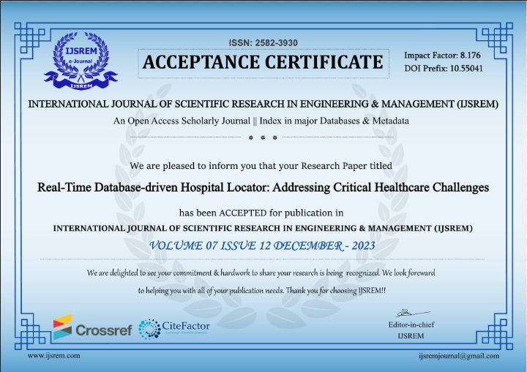
Publication Details
Research Paper ID : IJSREM27772
The Research Paper issued by “Internal Journal of Scientific Research In Engineering & Management (IJSREM)” comes under the UGC care.
Publishing Authors Are:-
Aakash Adhikari ,Md Zohaer Anfaz M.A ,Kaousthub Reddy ,Mohammed Faisal Khan, Tushar Patel, Dr.Nagaraja S R

Slide 43

Thank You

